Slide 1
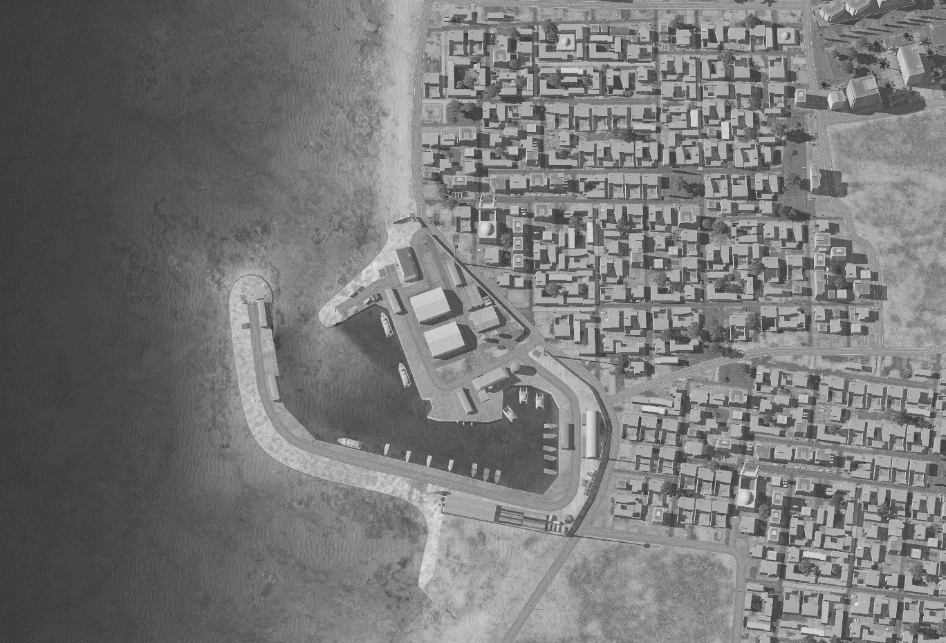
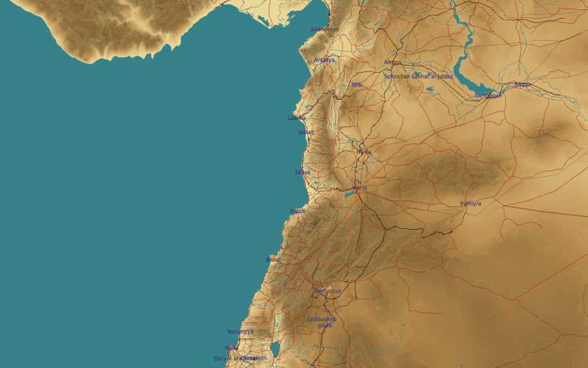
SYTGT005 JABLAH NAVY PORT
N
05
1
2
3
4
DESIRED POINT of IMPACT:
DPI 1 - N35 21.660 E 35 55.175 / 26ft/ 500lb PGM
DPI 2 - N35 21.640 E 35 55.190 / 23ft/ 2000lb PGM
DPI 3 - N35 21.622 E 35 55.200 / 24ft/ 2000lb PGM
DPI 4 - N35 21.603 E 35 55.230 / 18ft/ 500lb PGM
DPI 5 - N35 21.577 E 35 55.289 / 25ft / 500lb PGM
DPI 6 - N35 21.538 E 35 55.218 / 25ft/ 500lb PGM
5
6
CDC - Civilian property and buildings of religious significance within 20m of the perimeter of the port.

